Slide 1
Introduction to software construction
TOPIC 1
UTM-SERG Research & Consultancy Team
School of Computing
Faculty of Engineering
Universiti Teknologi Malaysia
UTM, Skudai, Johor.

Slide 2
AGENDA
Agenda 1: Object Oriented Paradigms
Agenda 2: Object Meta-model
Agenda 3: Revision of OO Programming
Agenda 3: Software Construction Paradigms
Agenda 4: Summary

Slide 3
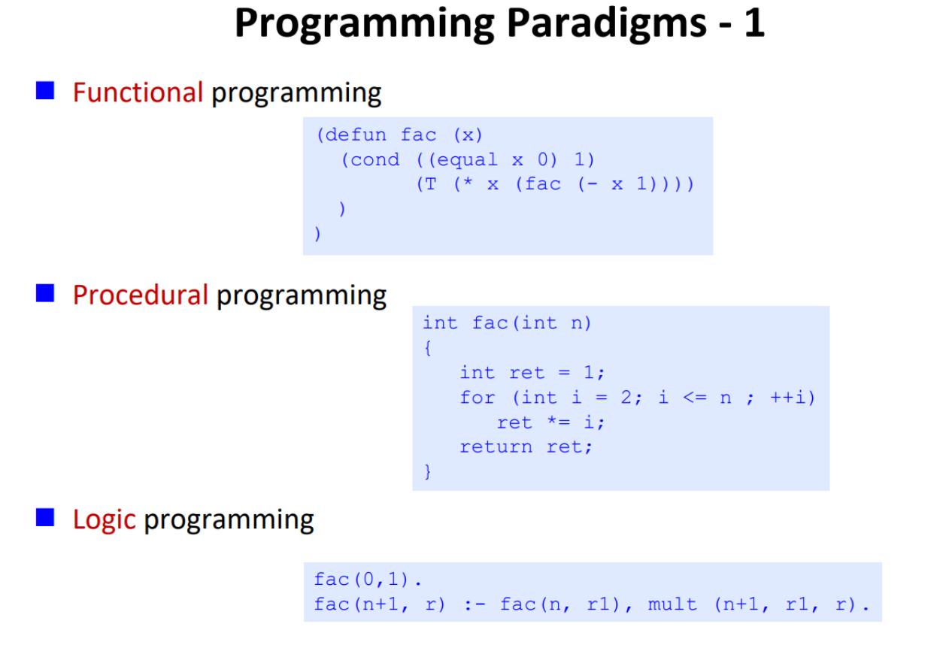
Object oriented paradigms

Slide 4
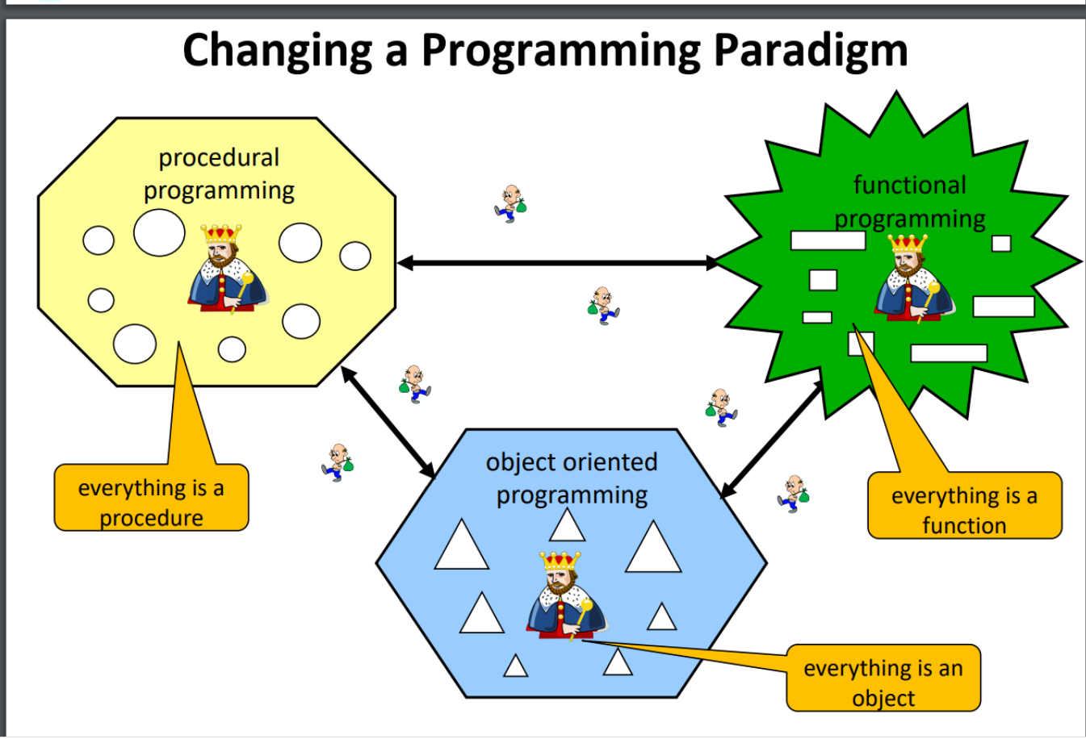
Object oriented paradigms

Slide 5
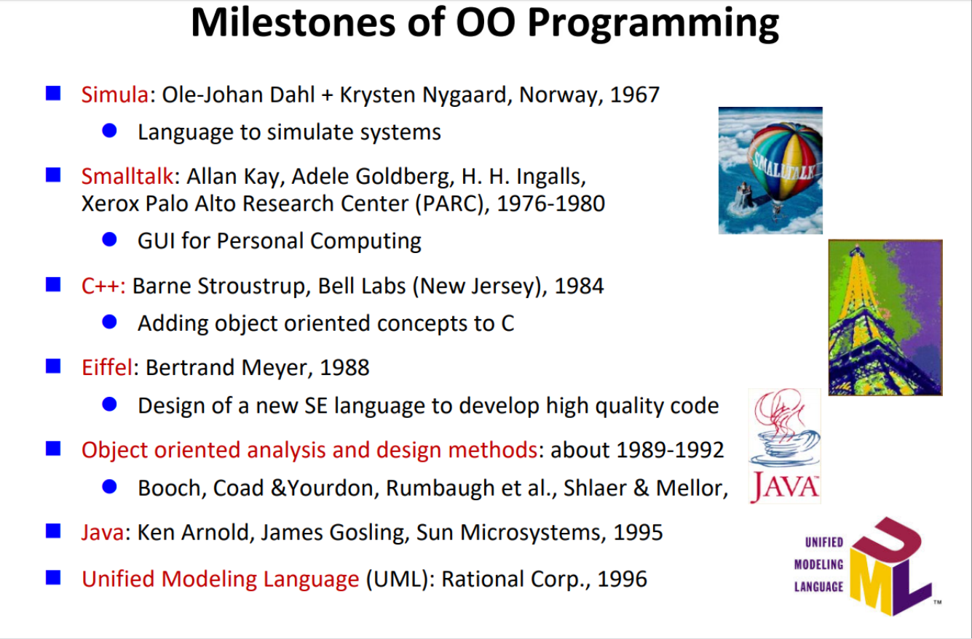
Object oriented paradigms

Slide 6
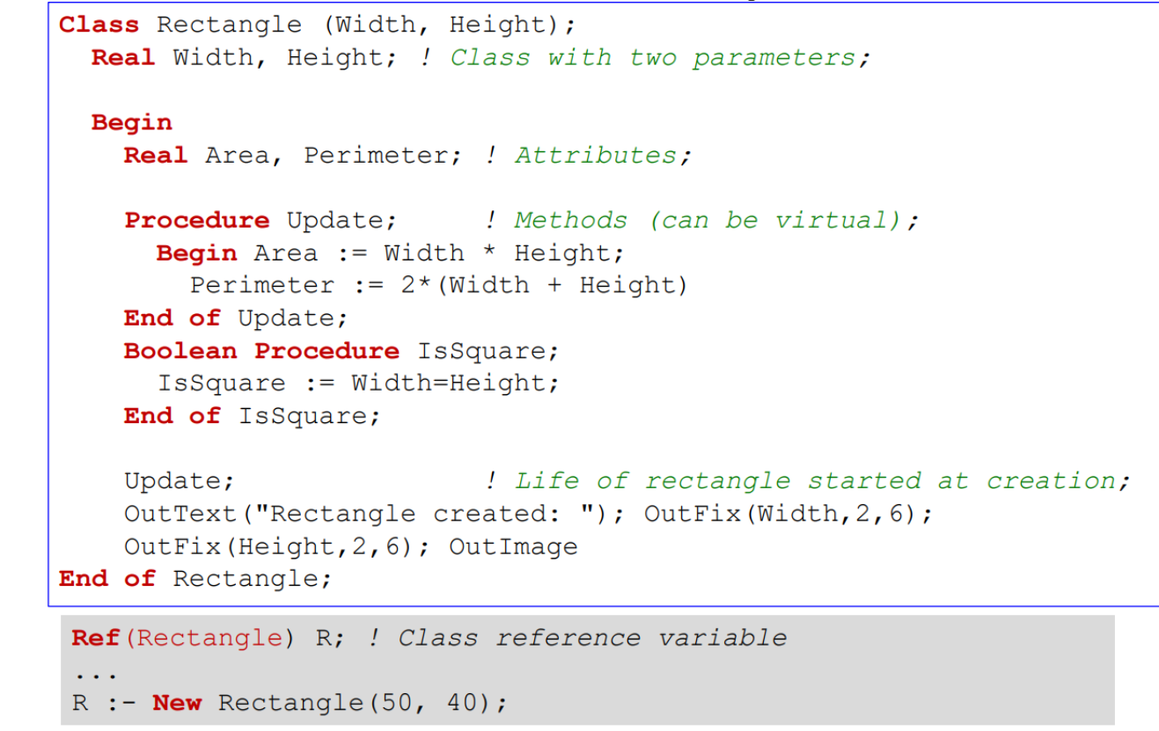
Object oriented paradigms

Slide 7
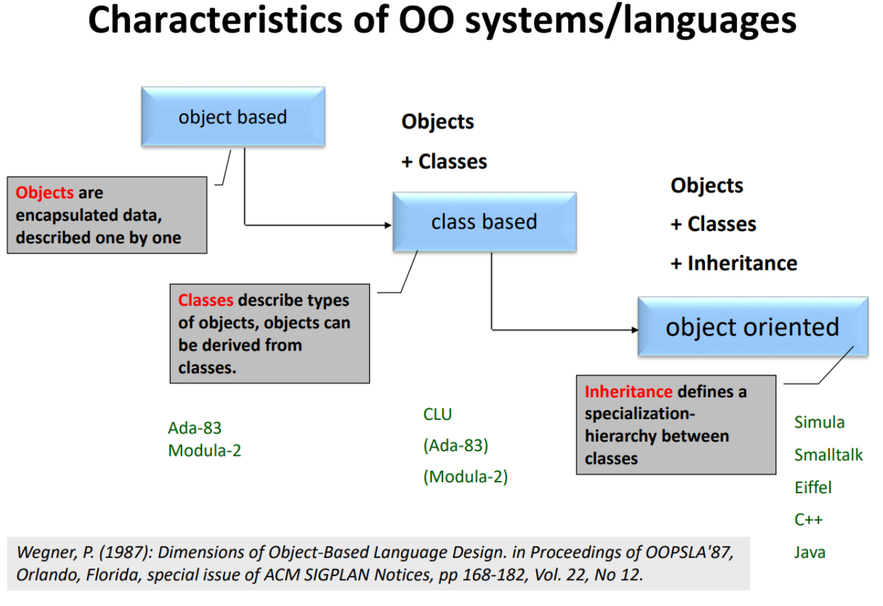
Object oriented paradigms

Slide 8
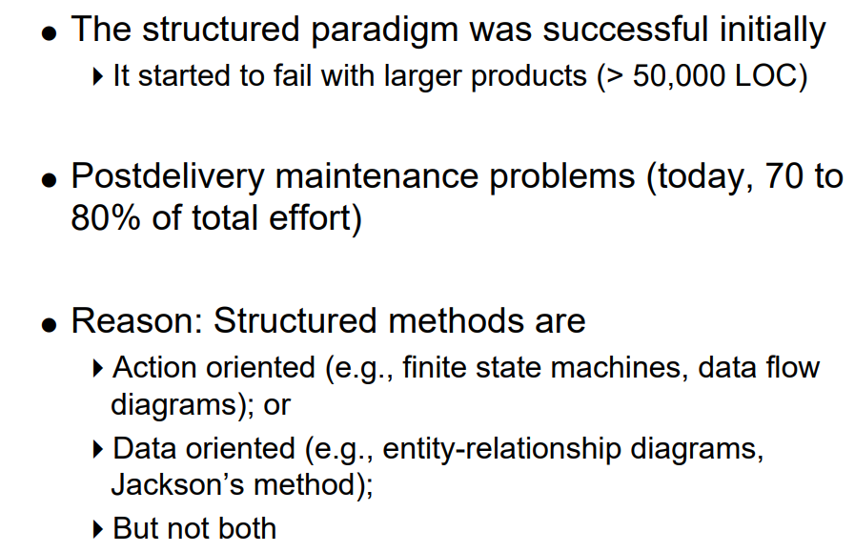
Object oriented paradigms

Slide 9
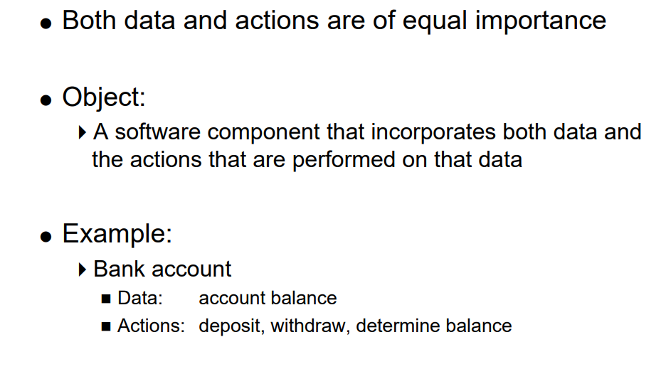
Object oriented paradigms

Slide 10
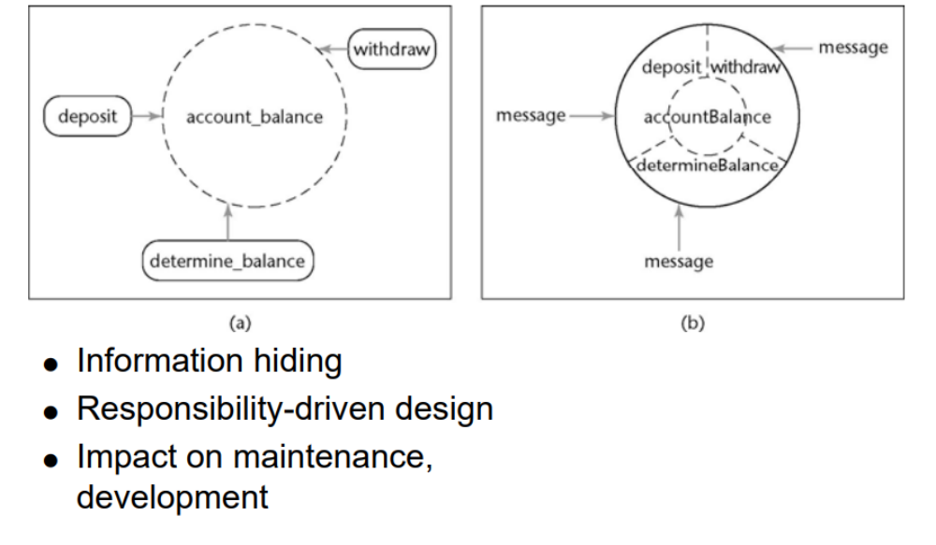
Object oriented paradigms

Slide 11
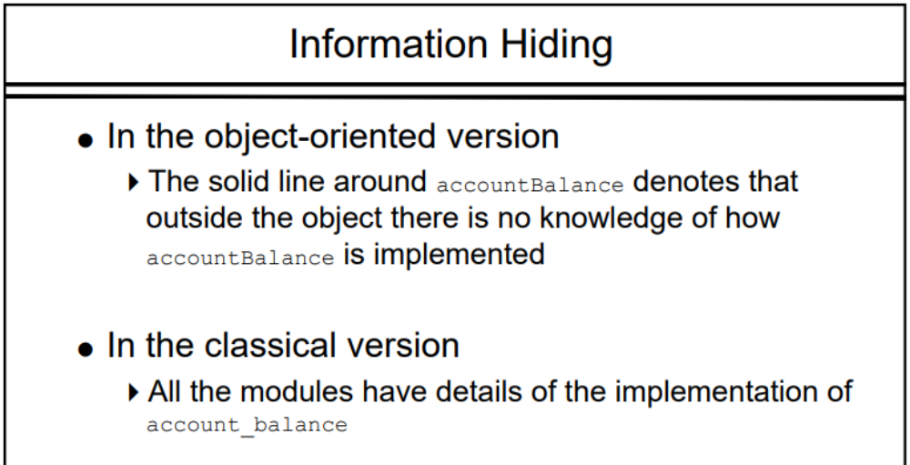
Object oriented paradigms-Information Hiding

Slide 12
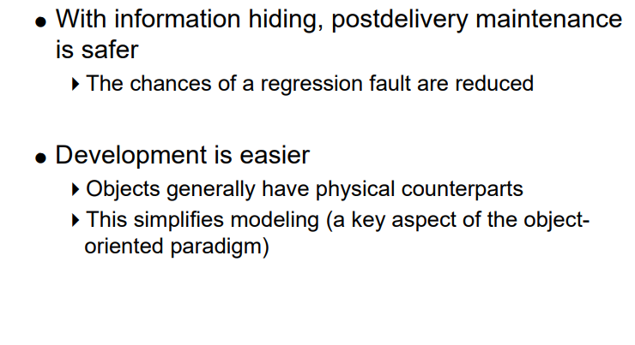
Strengths of the Object-Oriented Paradigm

Slide 13
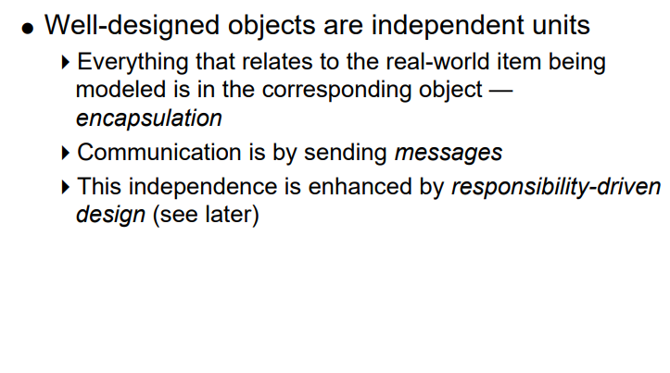
Object oriented paradigms

Slide 14
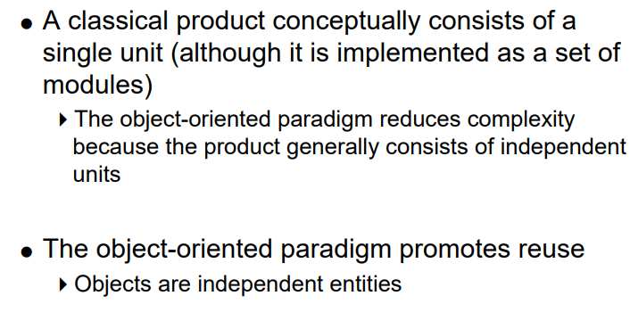
Object oriented paradigms

Slide 15
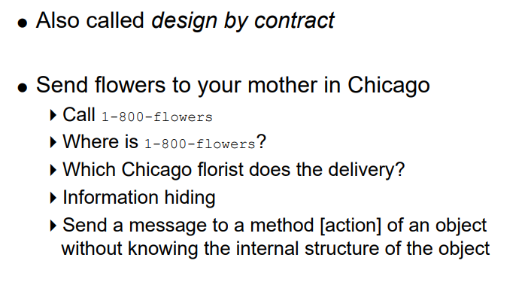
Object oriented paradigms-Responsibility-Driven Design

Slide 16
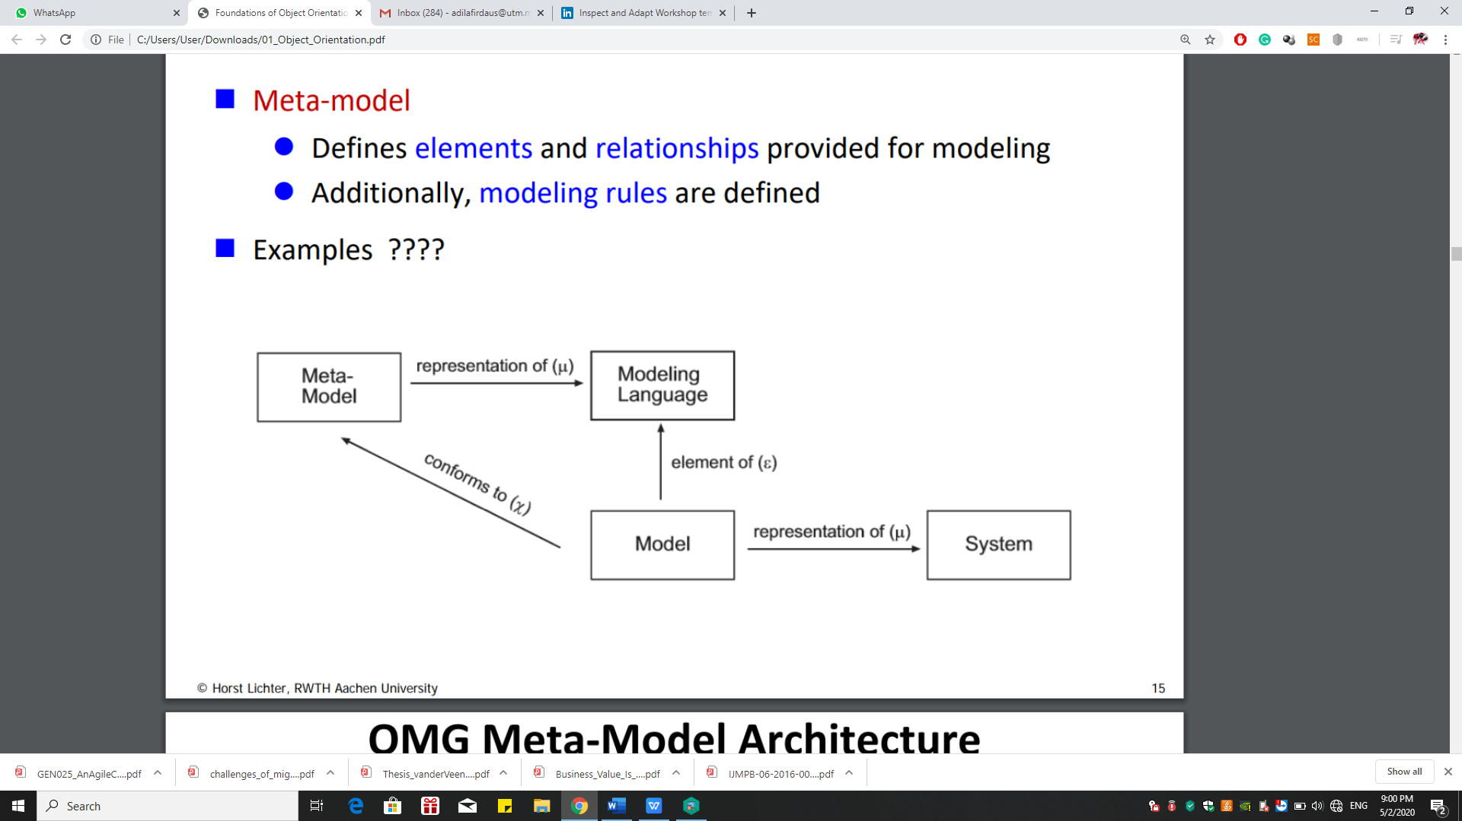
Object Meta-model

Slide 17
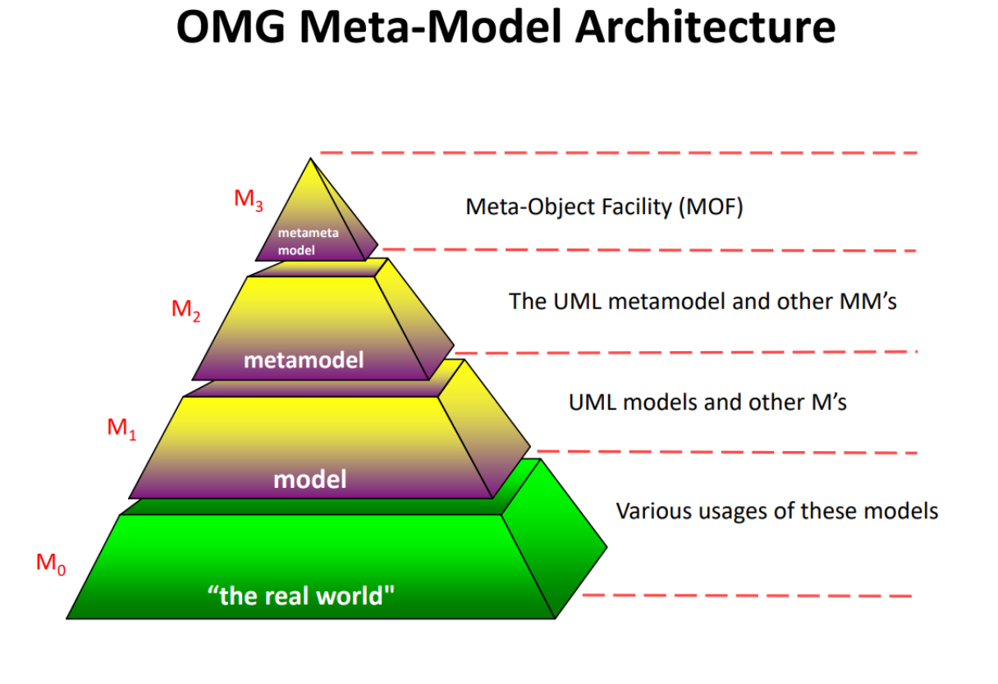
Object Meta-model

Slide 18
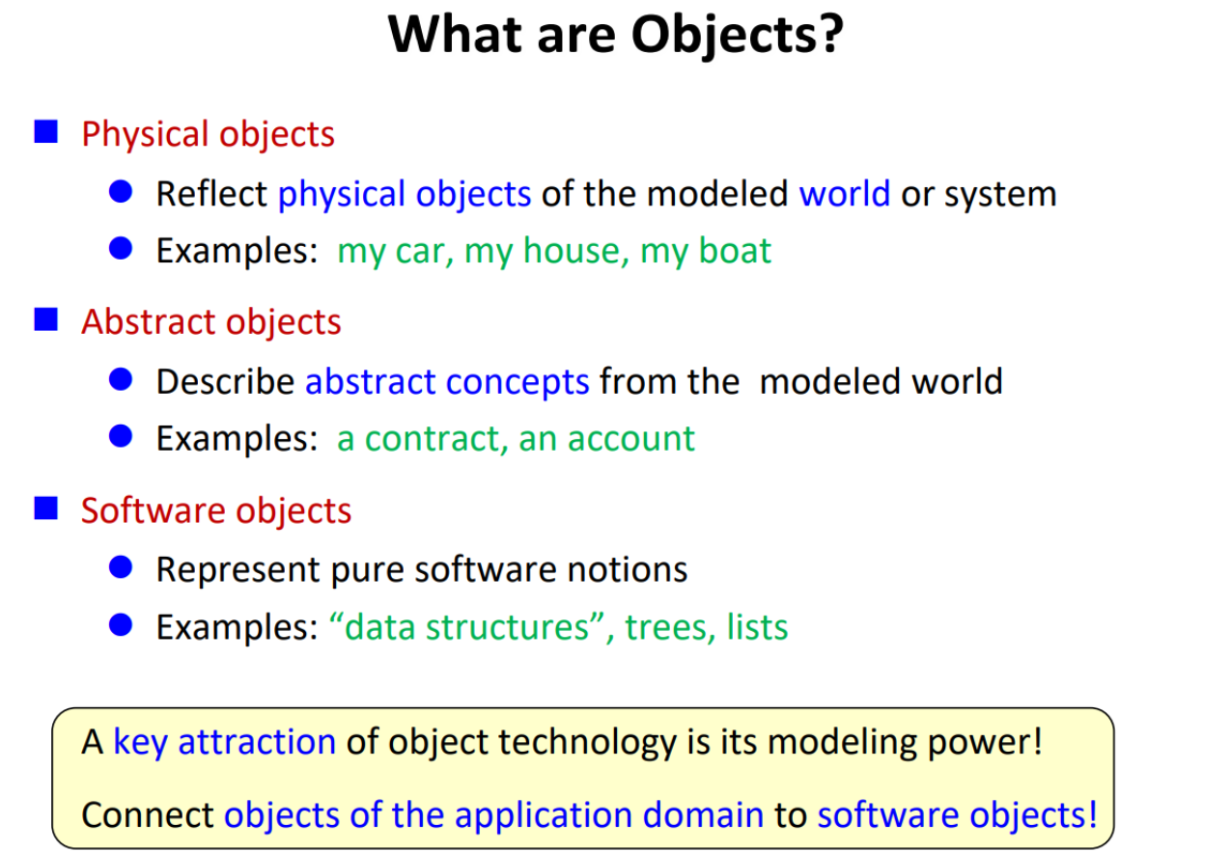
Revision of OO Programming

Slide 19
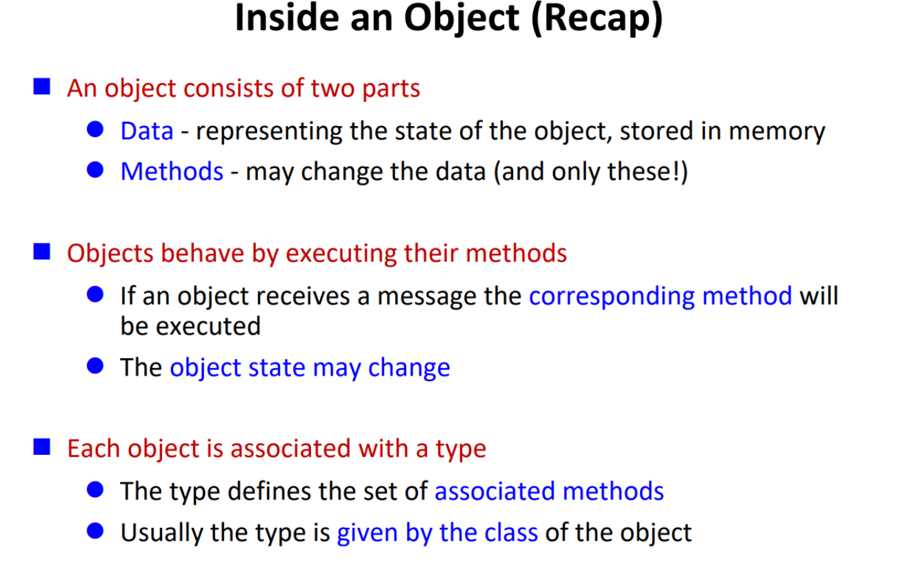
Revision of OO Programming

Slide 20
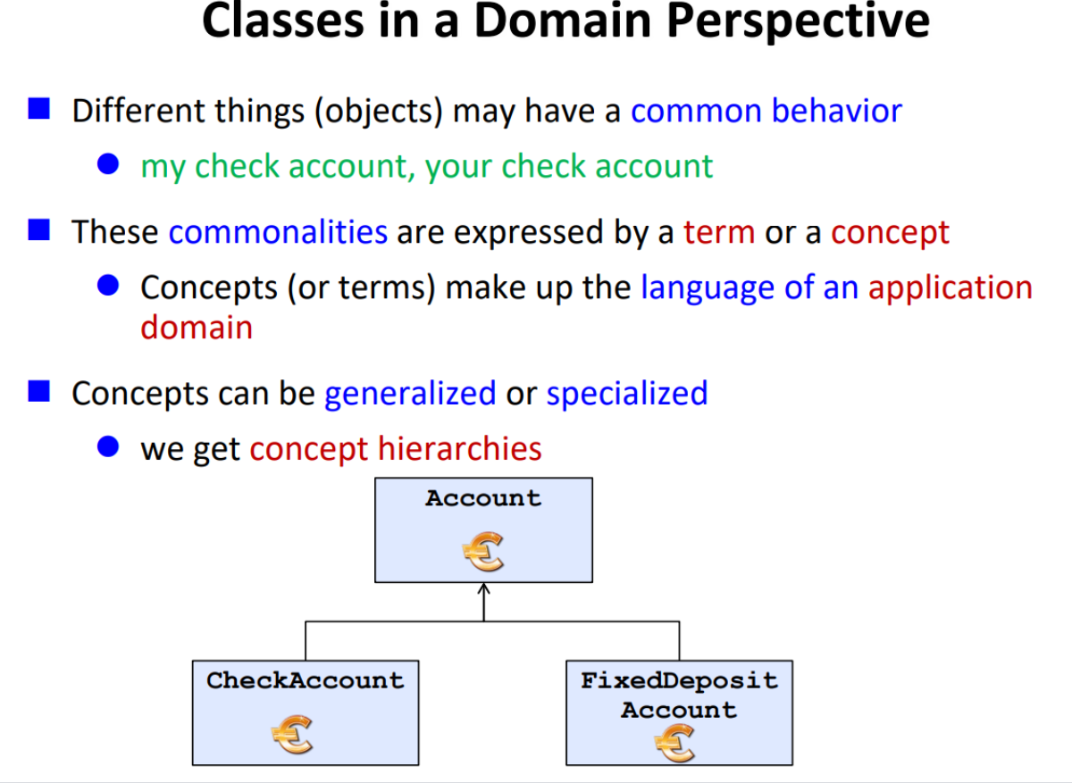
Revision of OO Programming

Slide 21
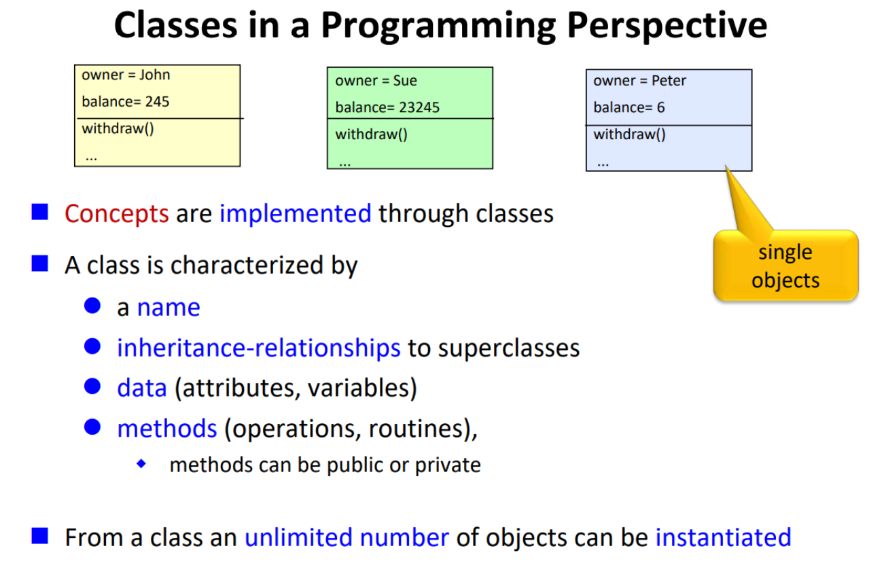
Revision of OO Programming

Slide 22
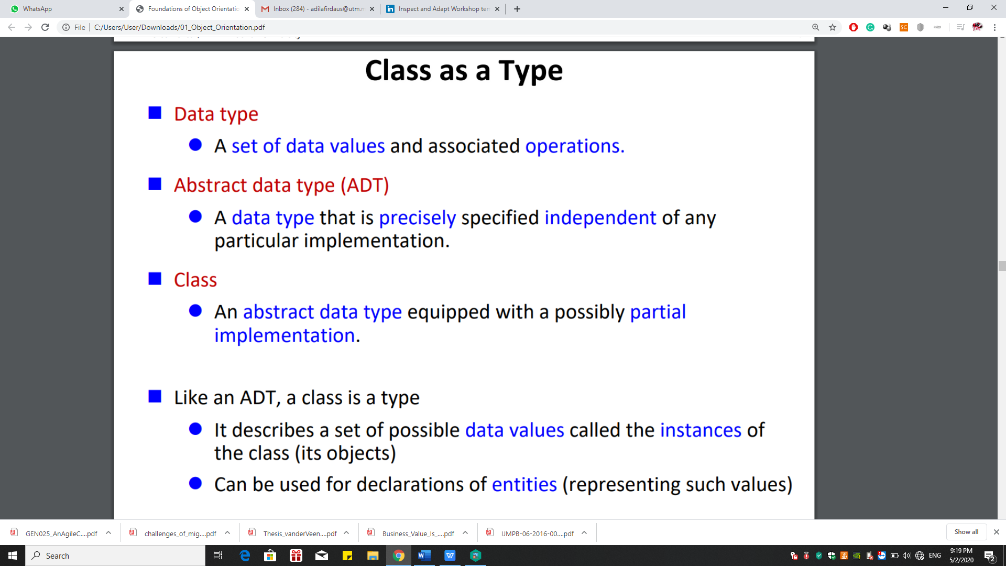
Revision of OO Programming

Slide 23
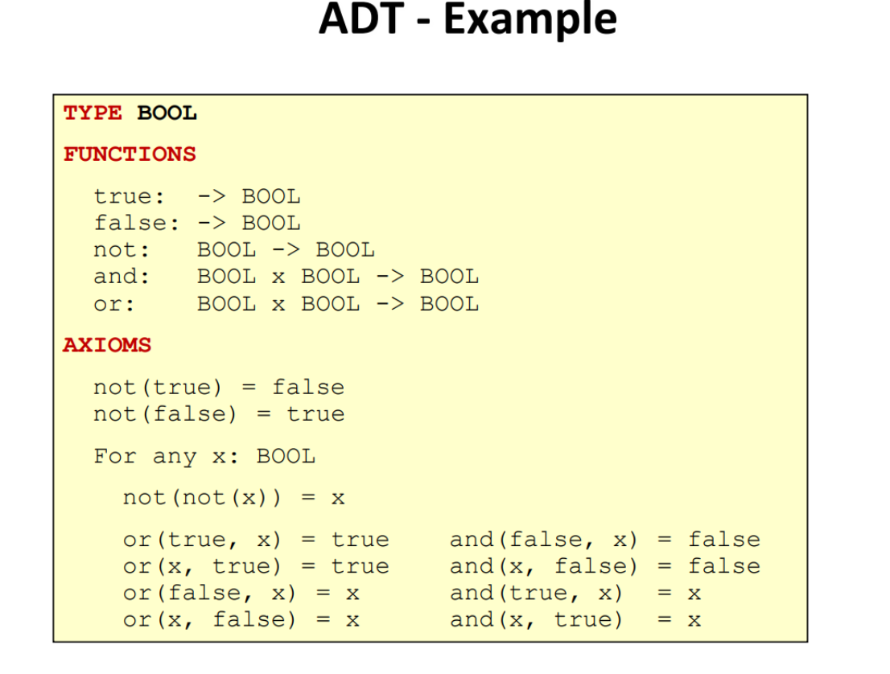
Revision of OO Programming

Slide 24
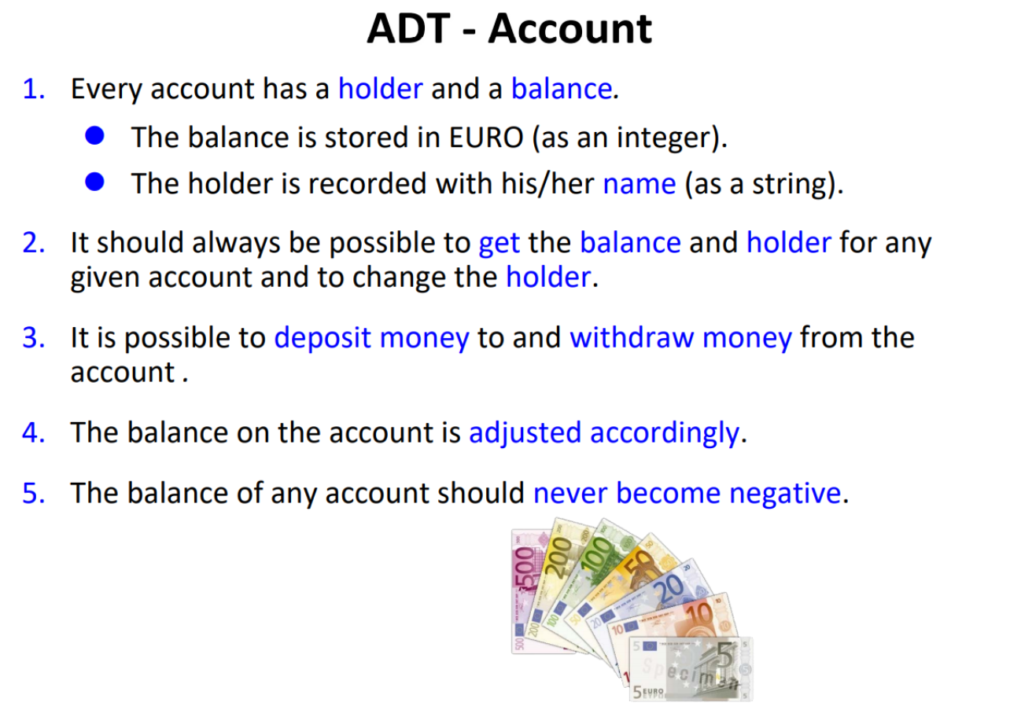
Revision of OO Programming

Slide 25
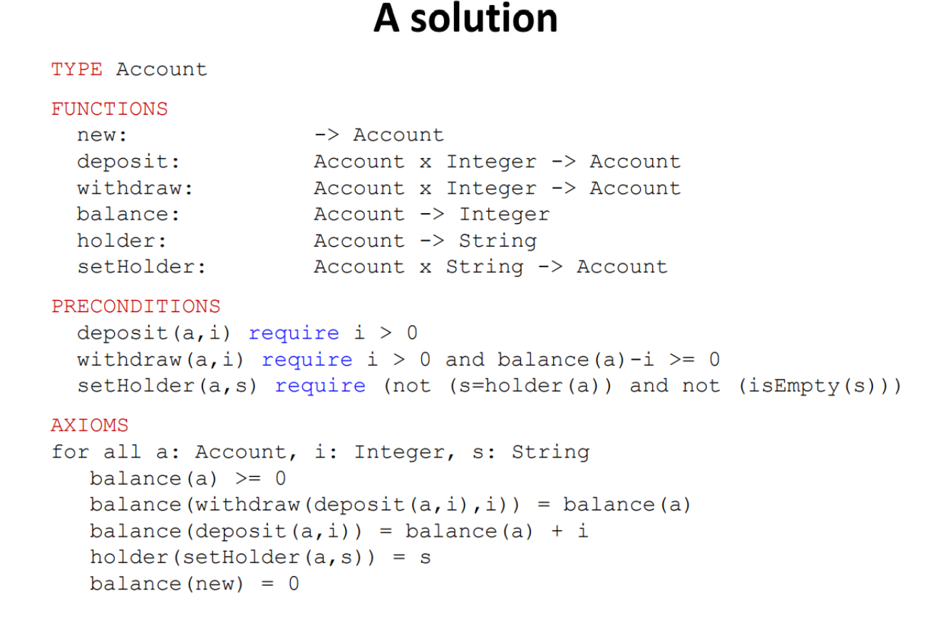
Revision of OO Programming

Slide 26
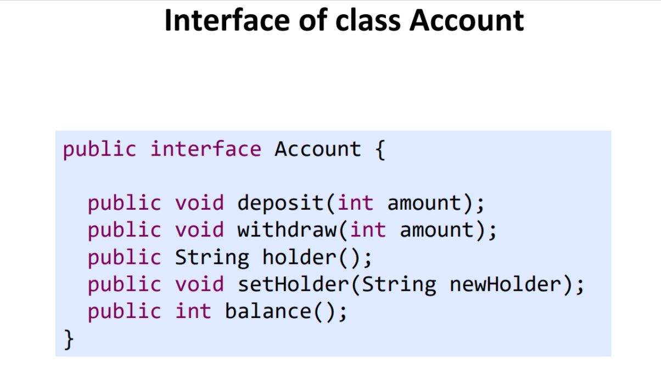
Revision of OO Programming

Slide 27
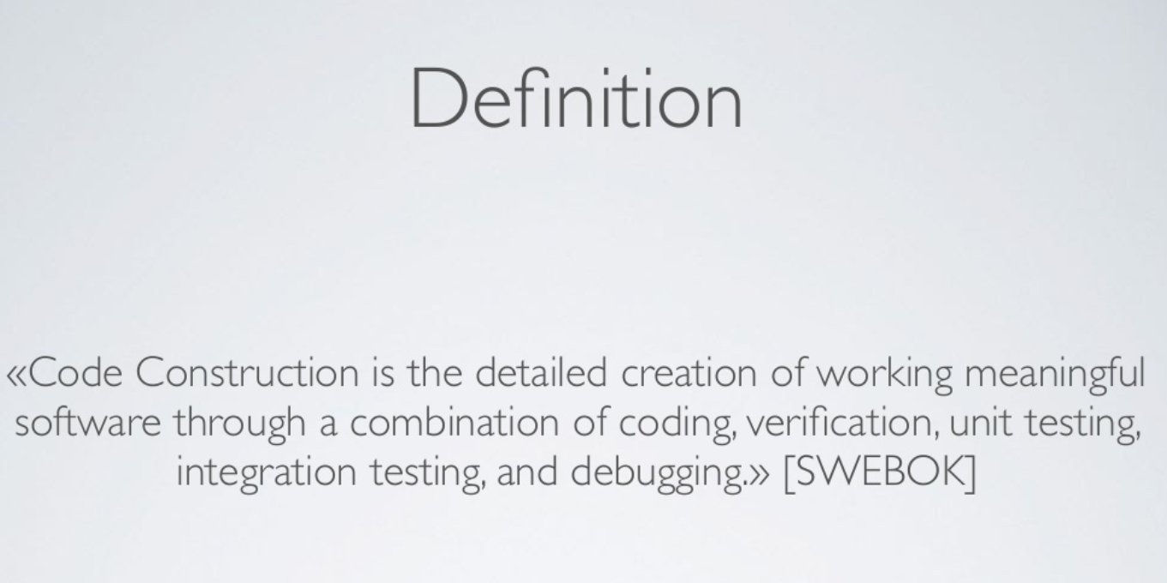
Software Construction Paradigms

Slide 28
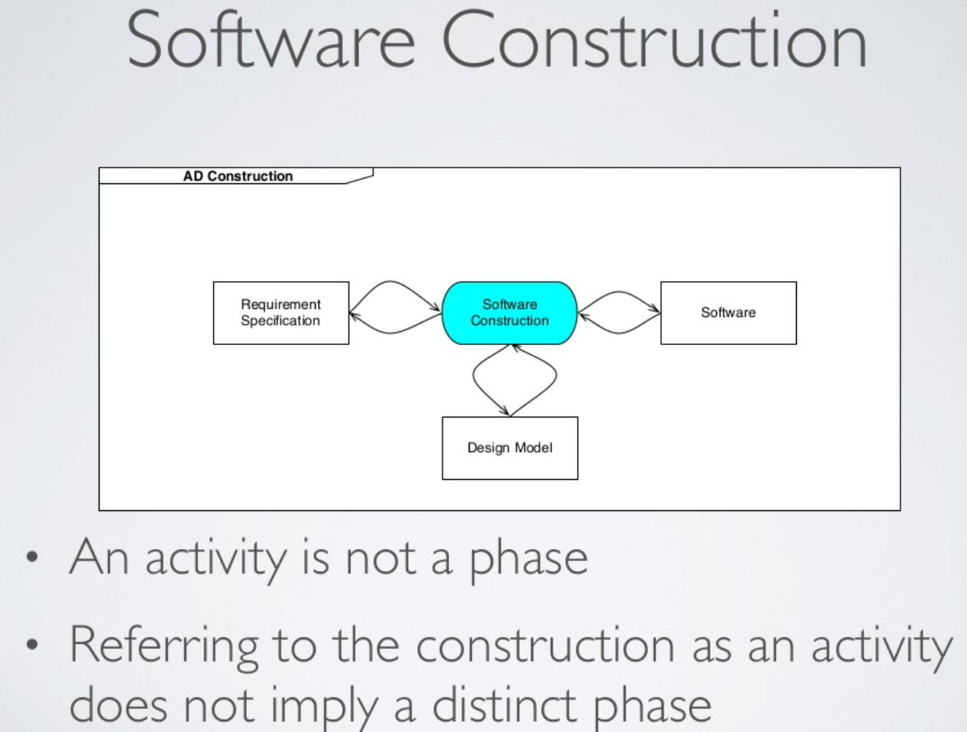
Software Construction Paradigms

Slide 29
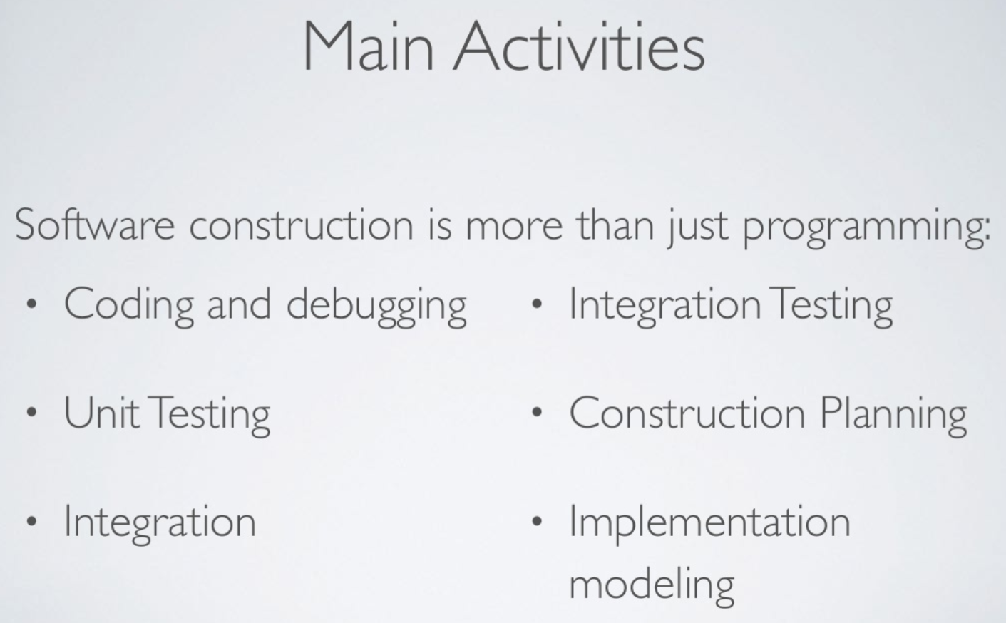
Software Construction Paradigms

Slide 30
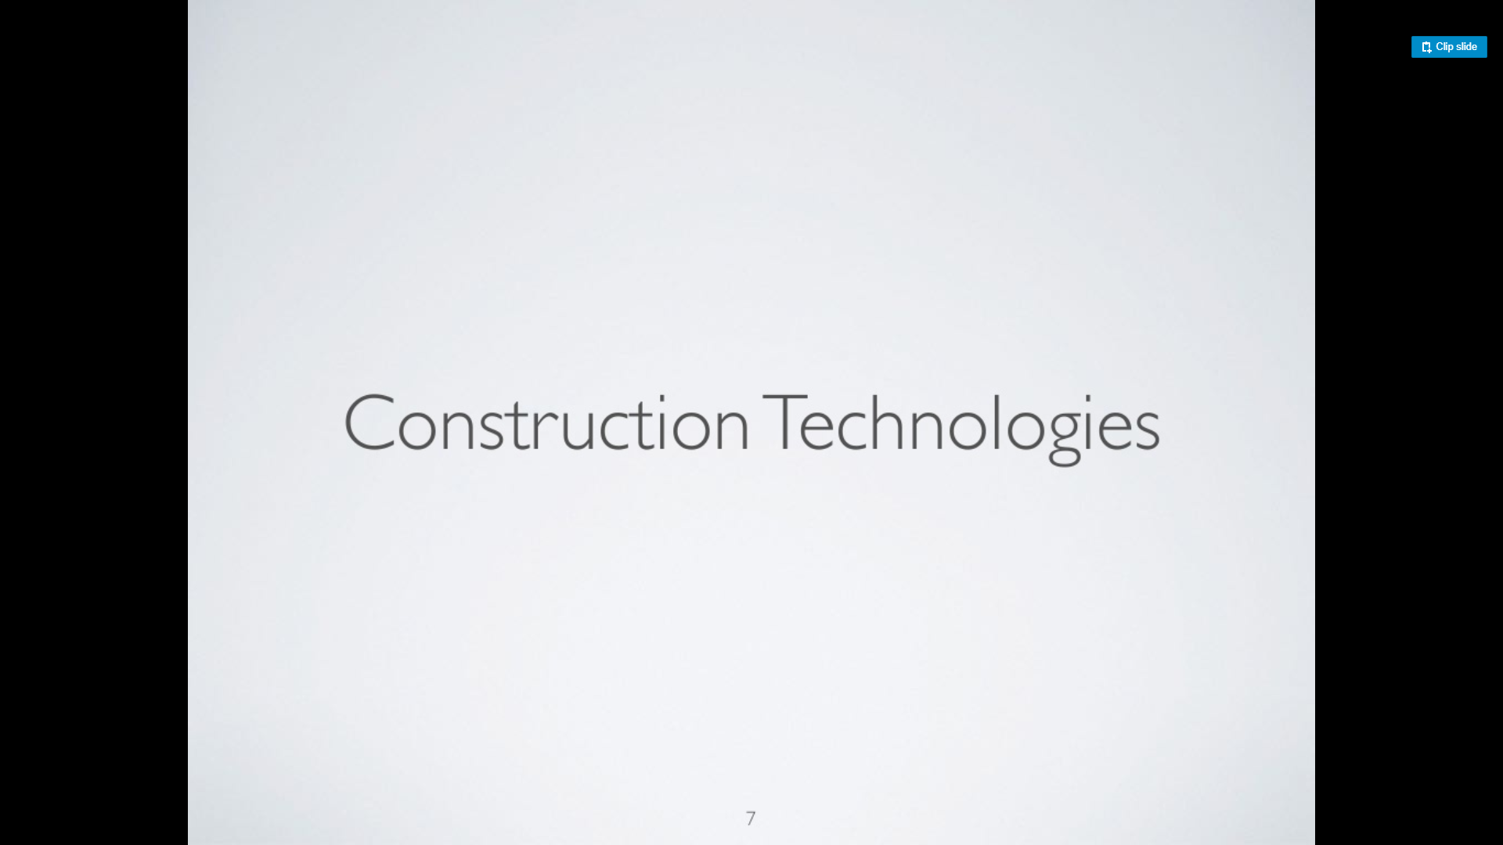
Software Construction Paradigms

Slide 31
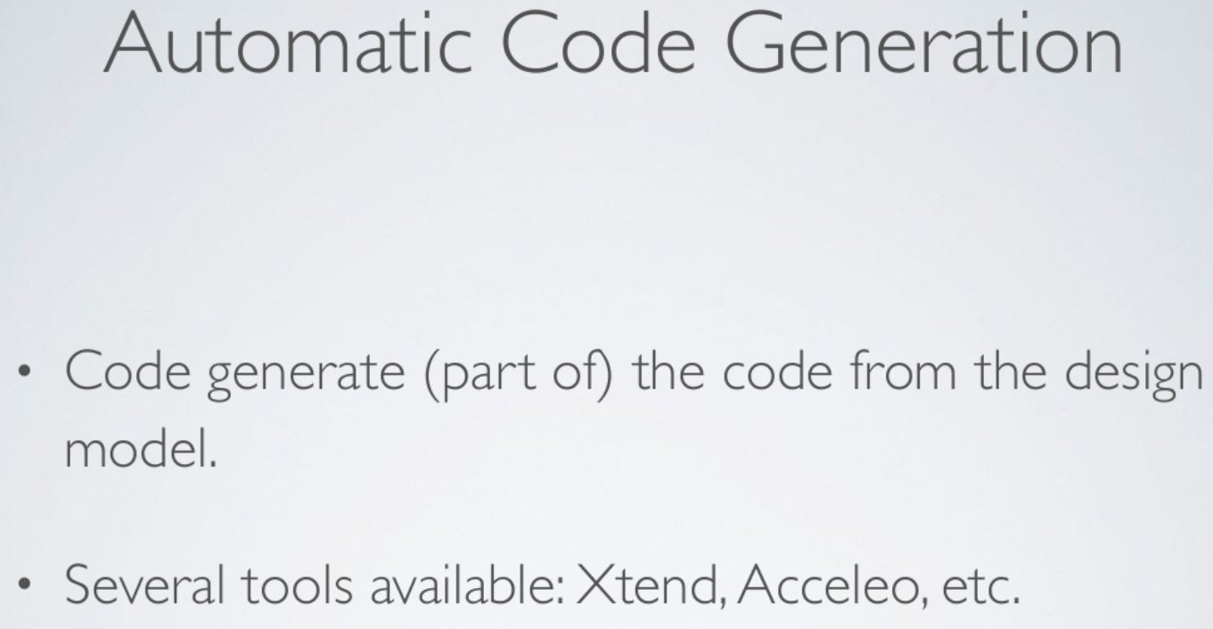
Software Construction Paradigms

Slide 32
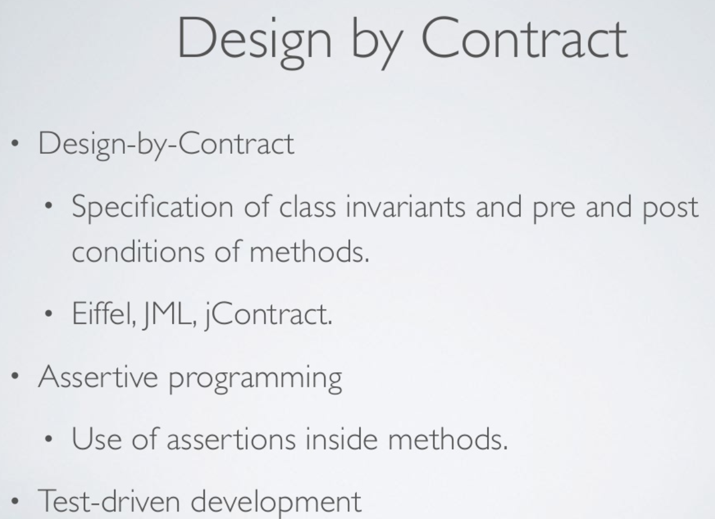
Software Construction Paradigms

Slide 33
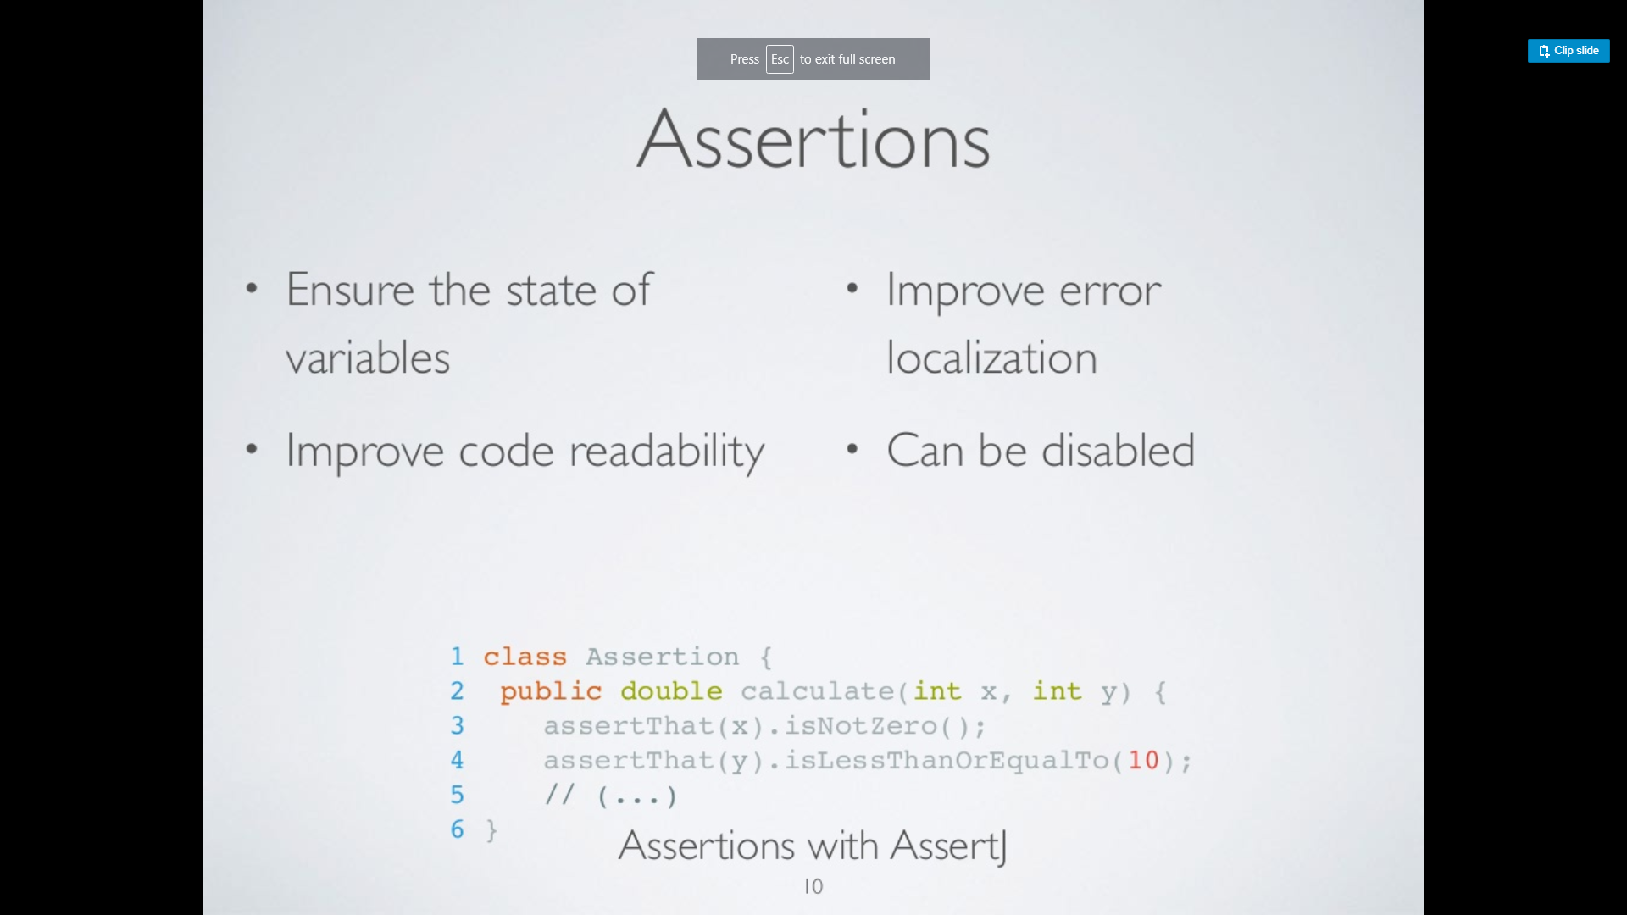
Software Construction Paradigms

Slide 34
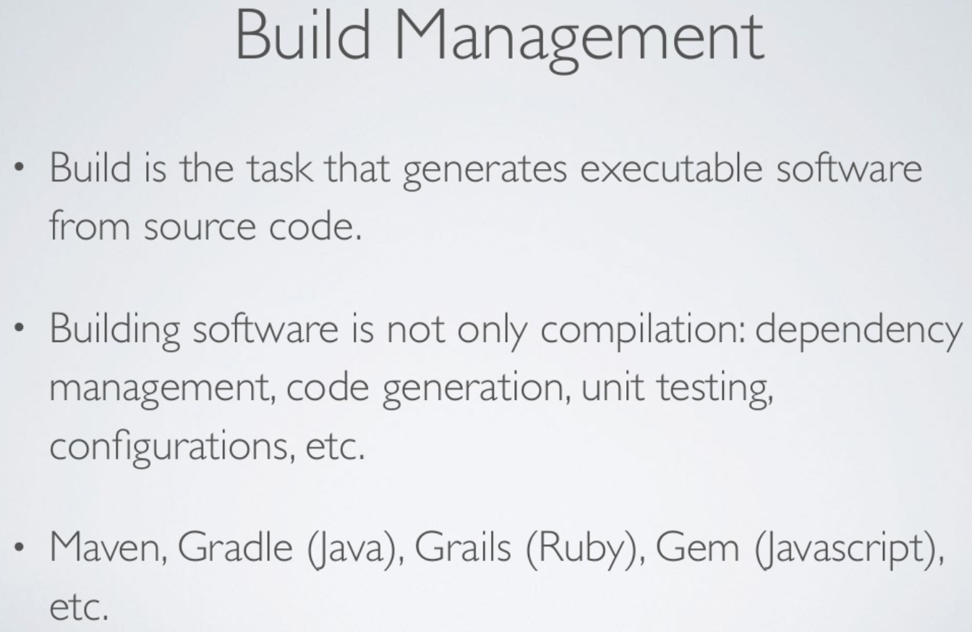
Software Construction Paradigms

Slide 35
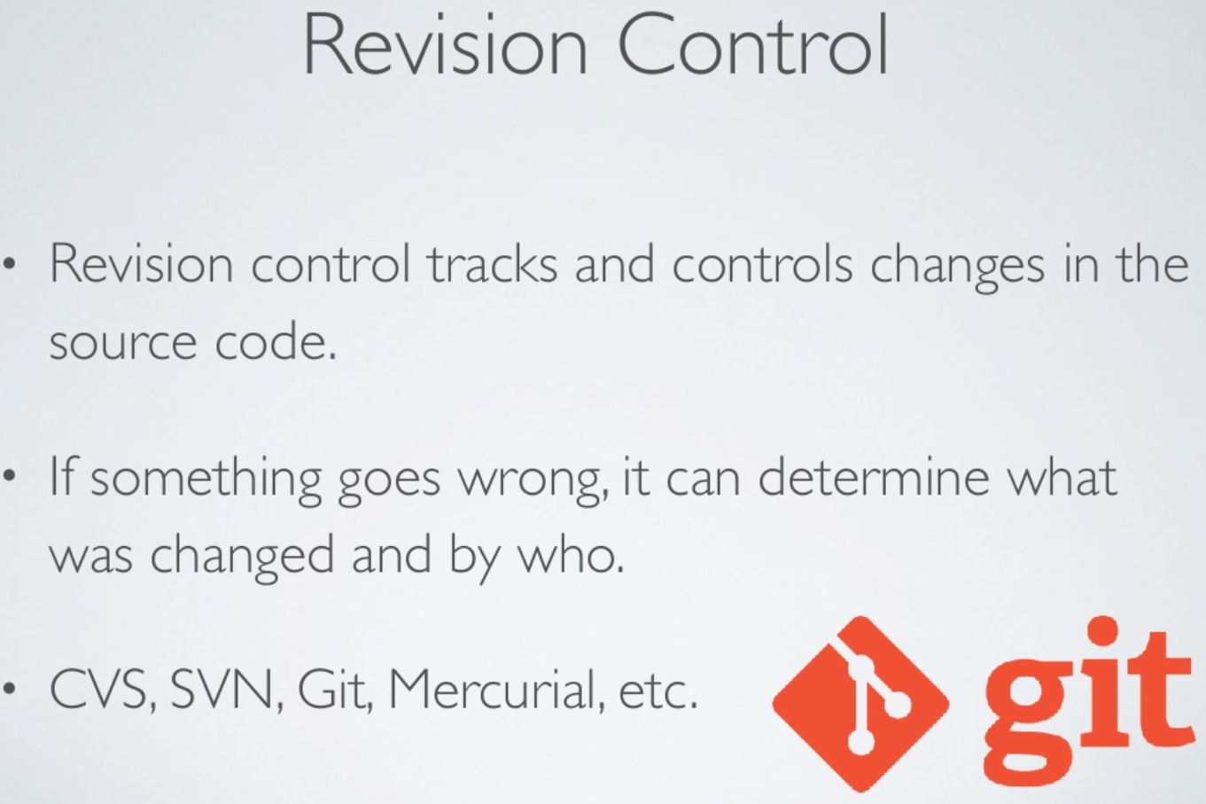
Software Construction Paradigms

Slide 36
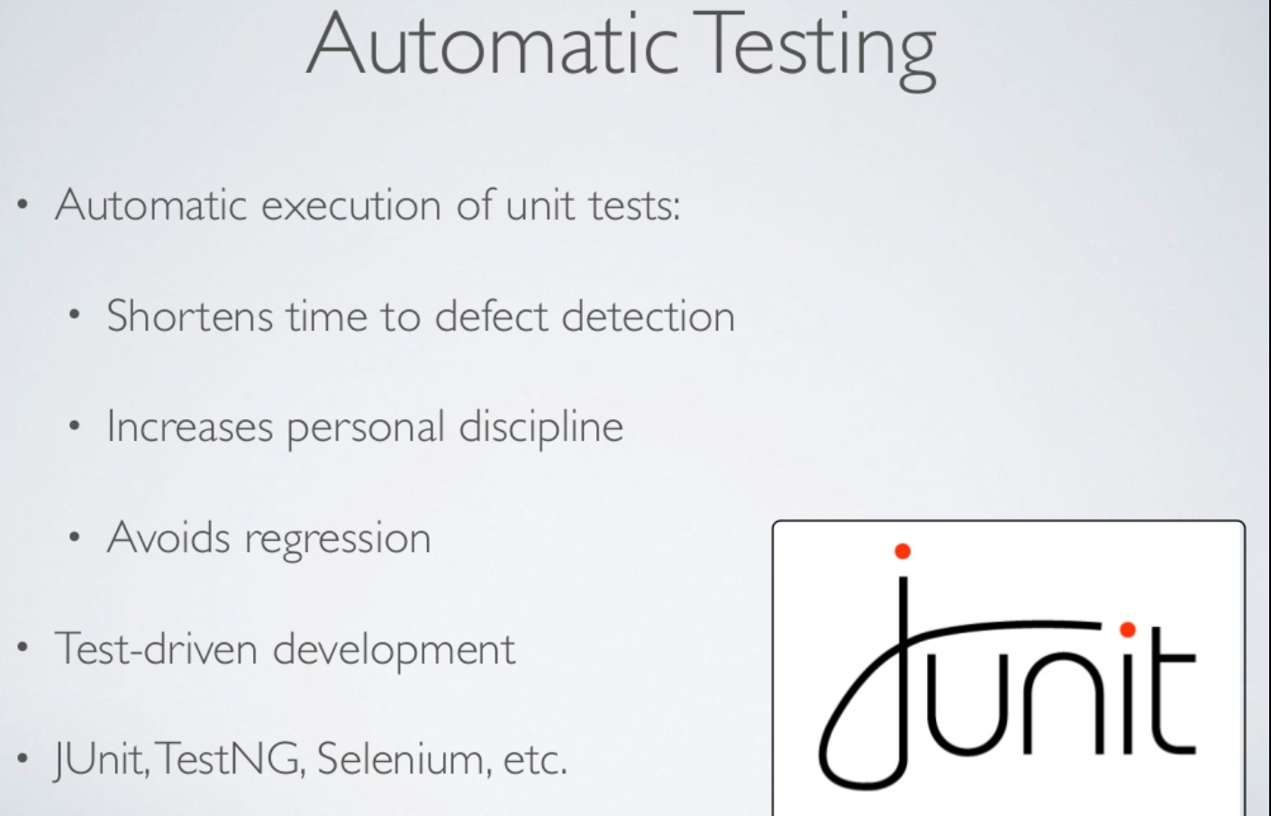
Software Construction Paradigms

Slide 37
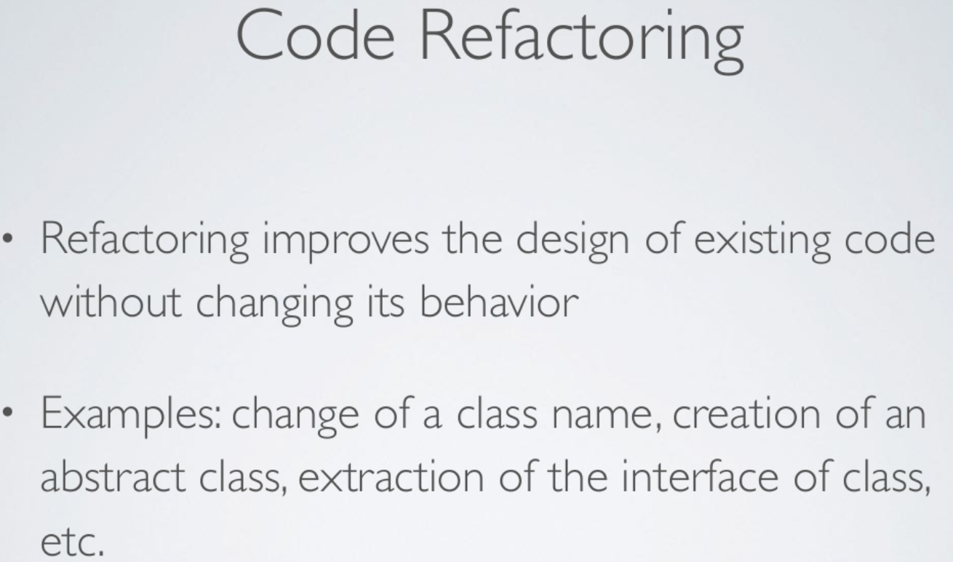
Software Construction Paradigms

Slide 38
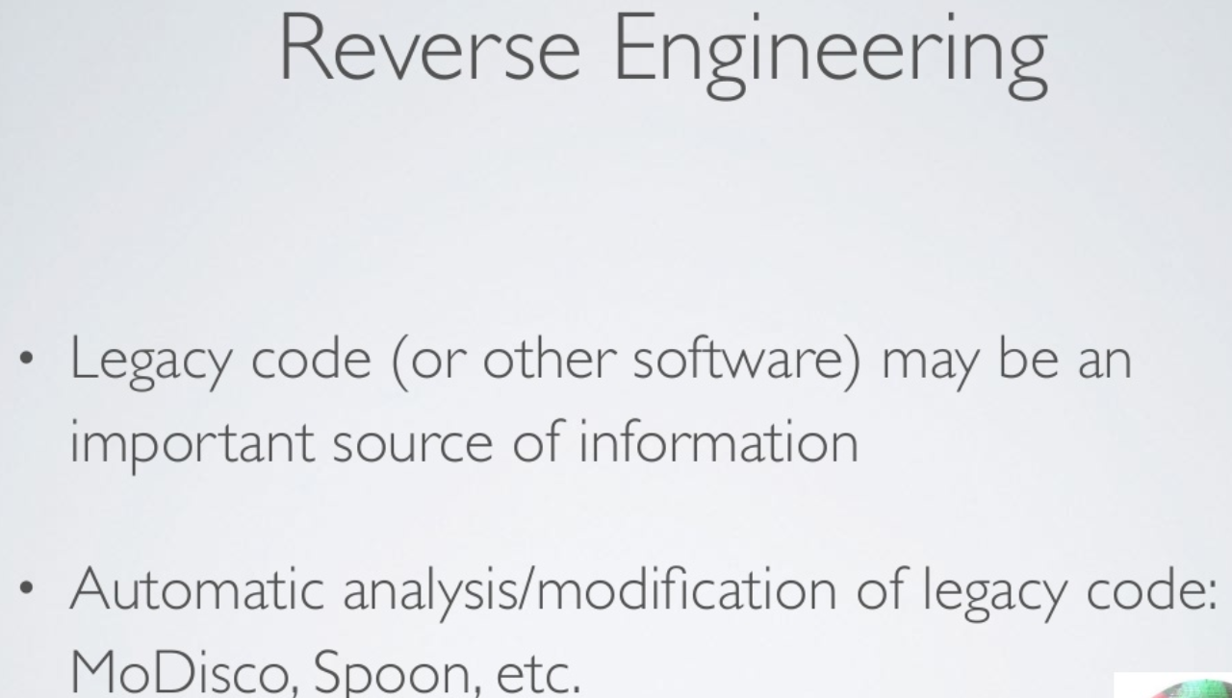
Software Construction Paradigms

Slide 39
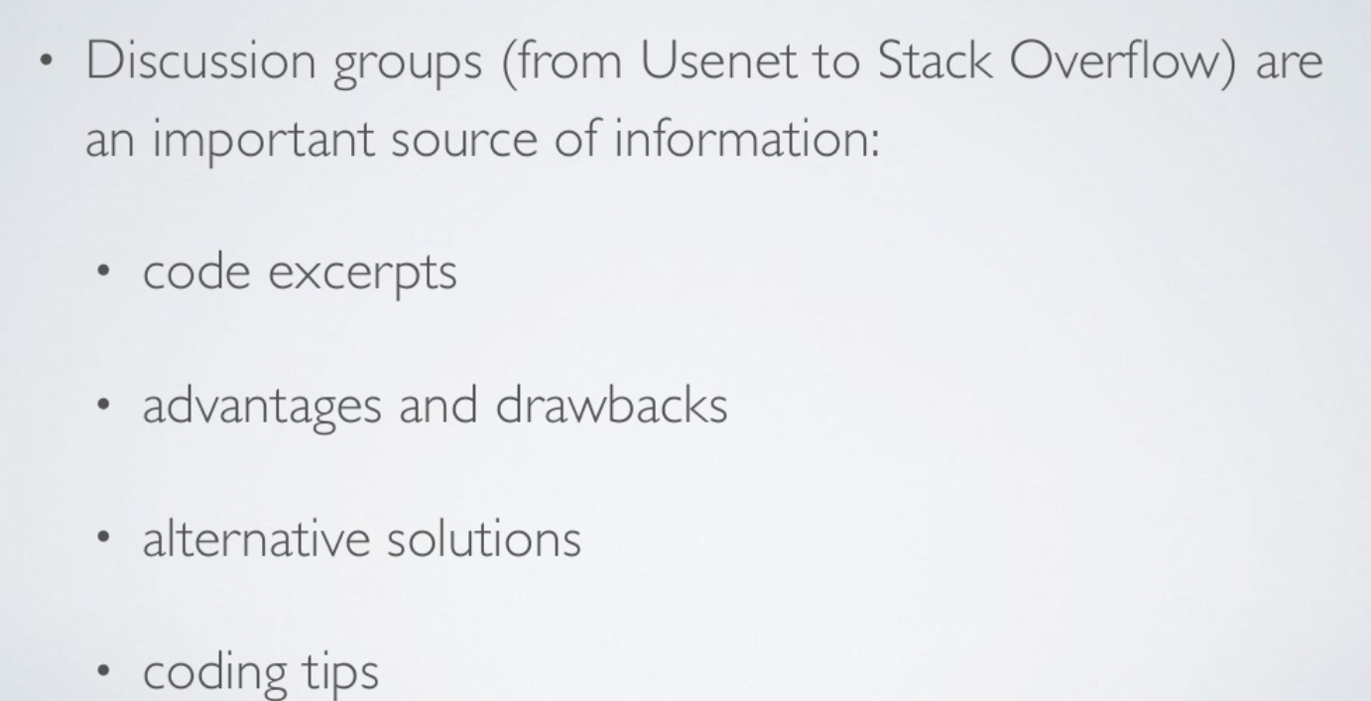
Software Construction Paradigms

Slide 40
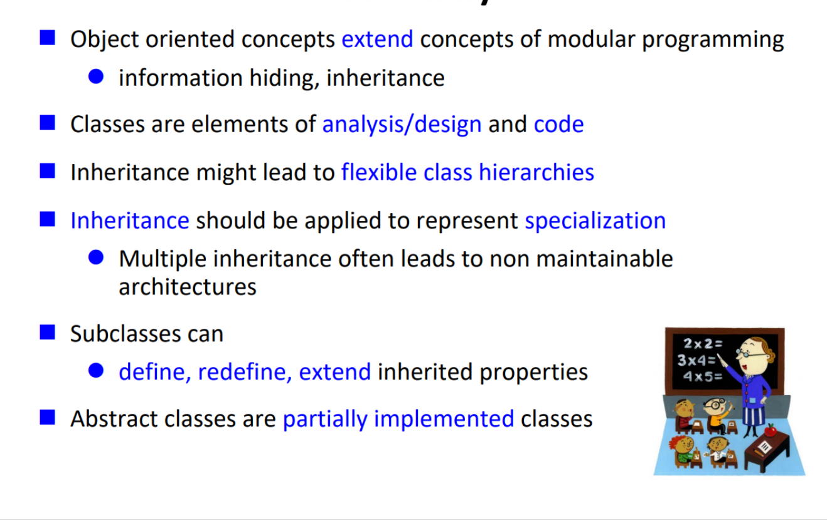
Summary

Slide 41
References
McGraw Hills 2007
Horst Lichter, RWTH Aachen University

